Slide 1
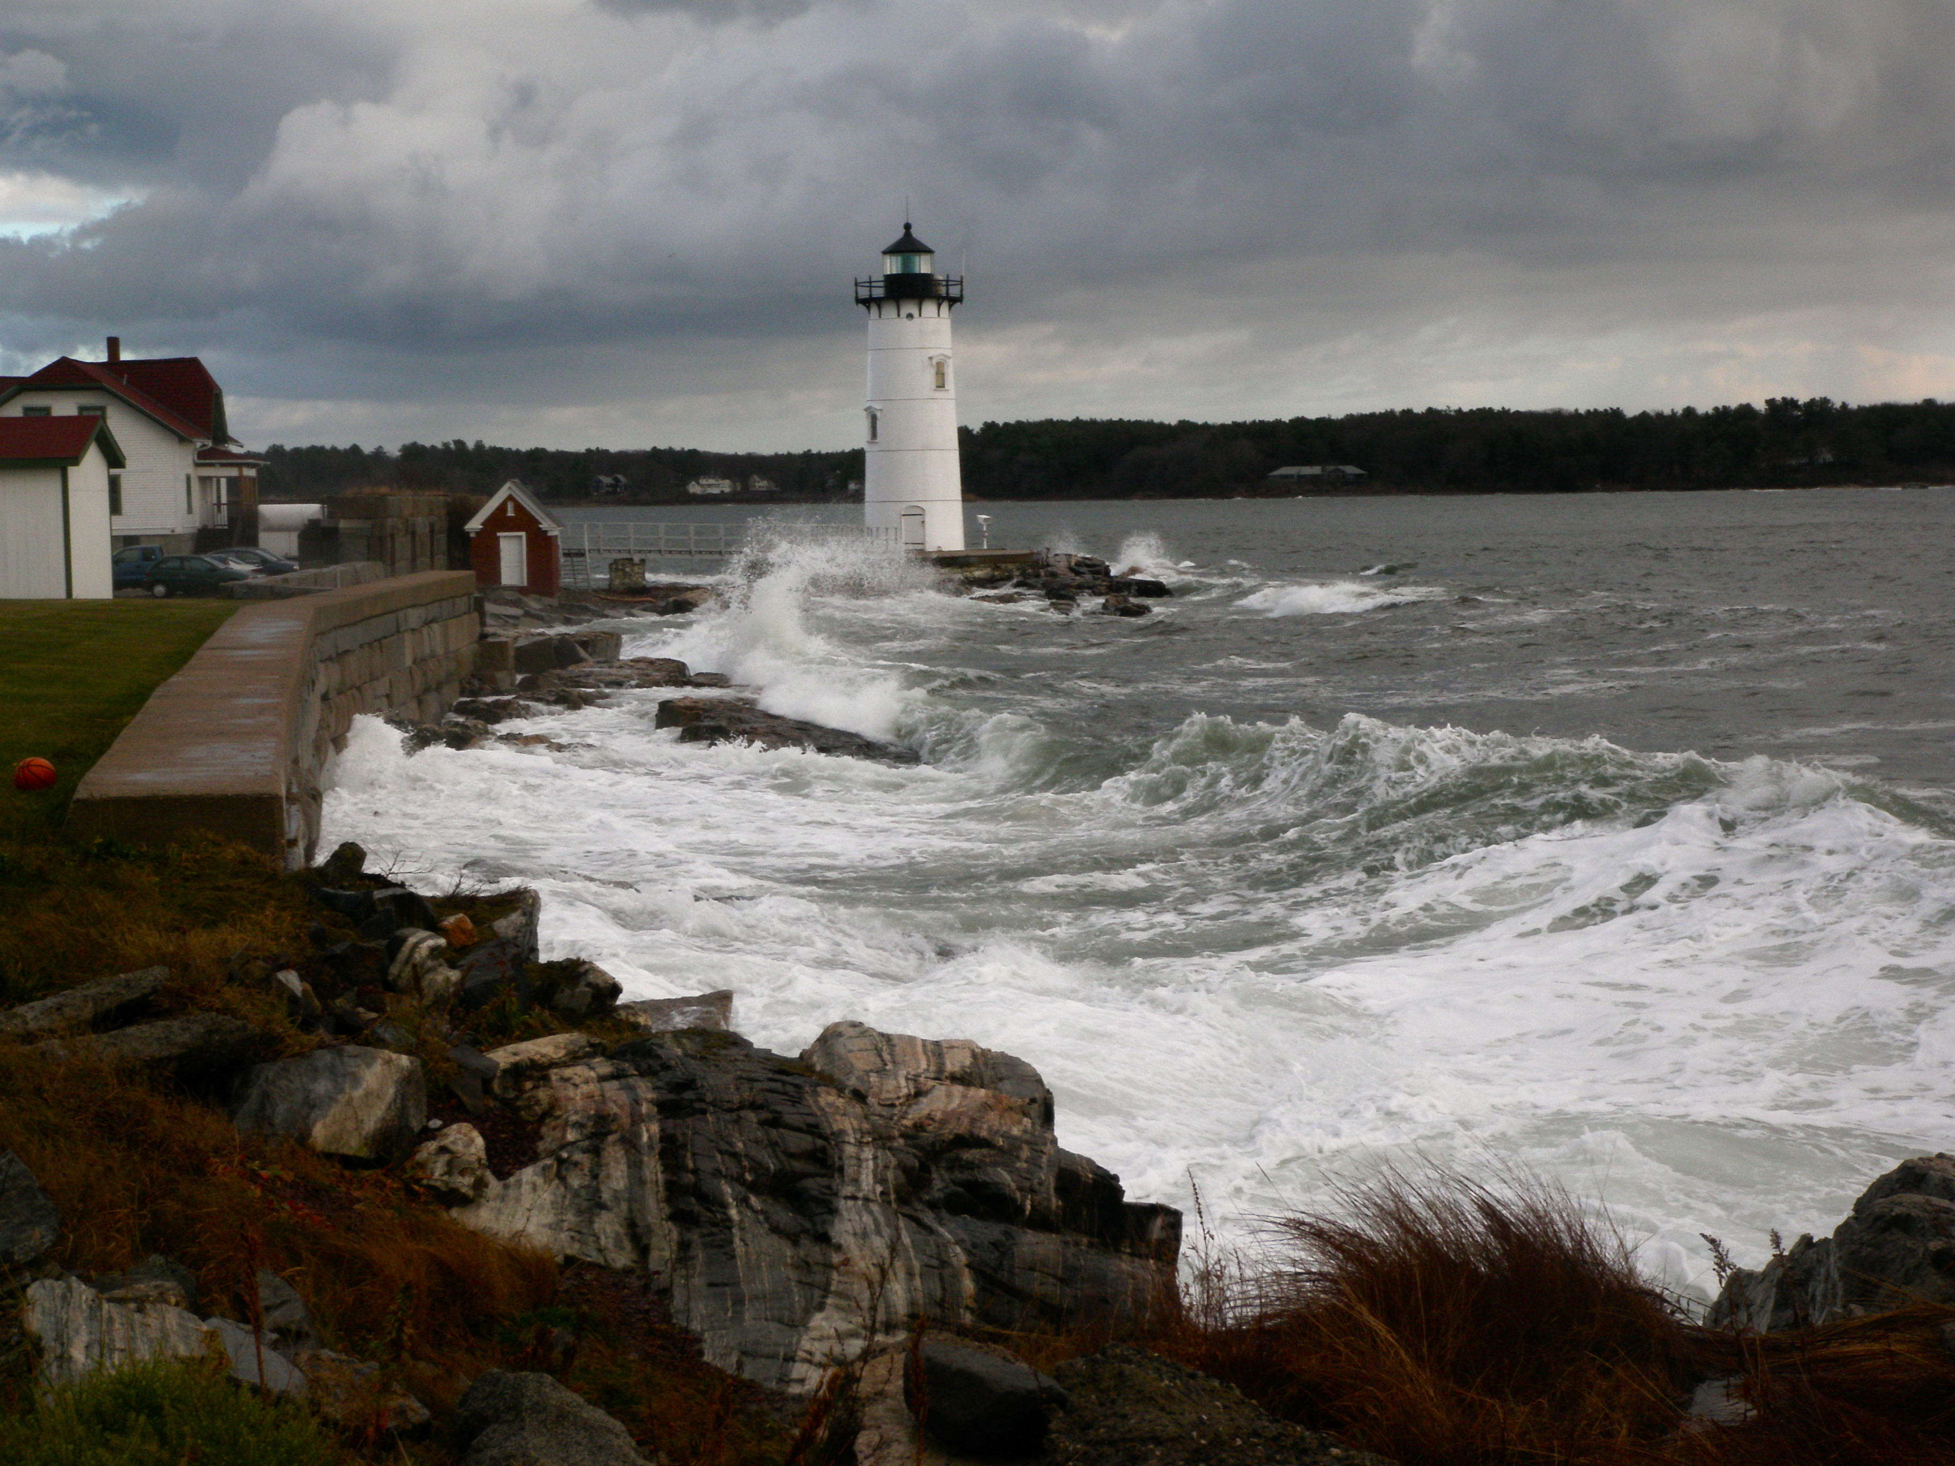


TideTools
A suite of programs for cleaning and processing tidal data
Captain Ben Smith
Center for Coastal and Ocean Mapping
Joint Hydrographic Center
Notes:
These tools were originally developed to process the data that was captured in Castine, Maine during the Summer Hydrographic course of 2008.
Since then, we used them on data from Fort Point, New Castle and Great Bay along with tests of tide stations using other technology than pressure.
They are now publicly available as Python programs run from a command line. They exist, not only as production tools, but as models for student work using any other data processing system, for example, MatLab.
You will find the command line options and parameters along with algorithms on the the CCOM wiki; search on “tideTools”

Slide 2
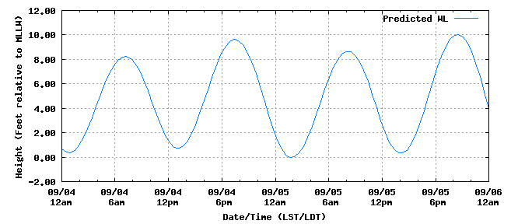
Tide predictors depend on field data collected over many years.
Tide prediction and image courtesy of NOAA
Center for Operational Oceanographic
Products and Services (CO-OPS)
Notes:
We need real tide data in order to do any mapping to tidal base lines.

Slide 3
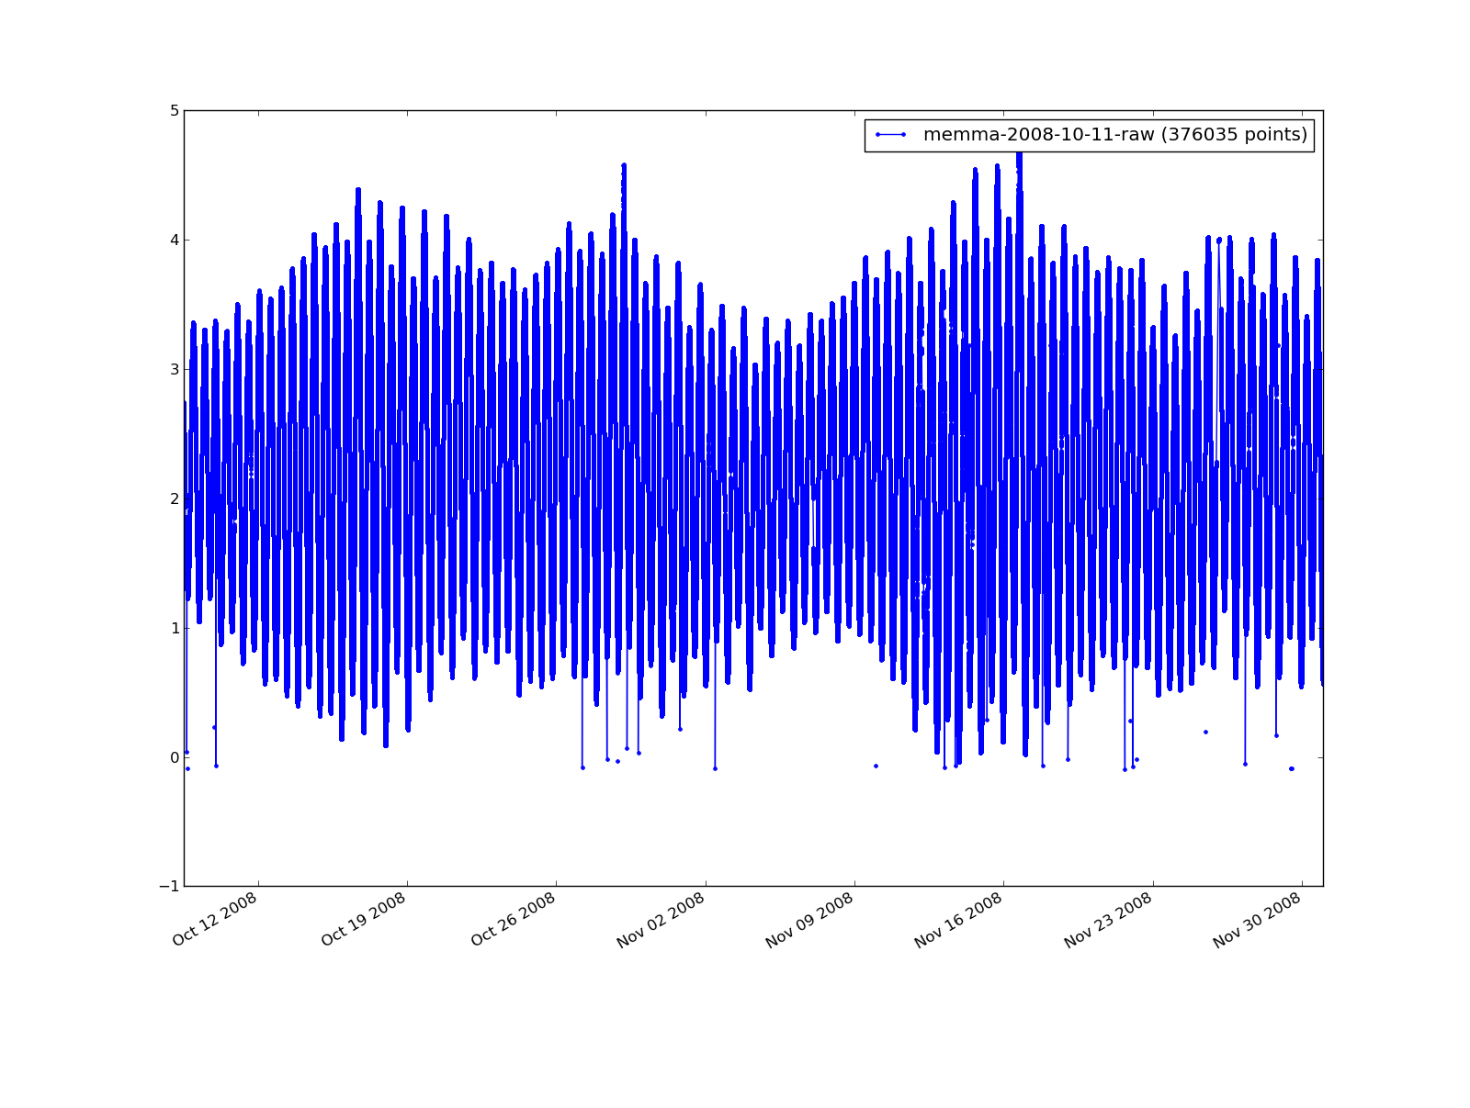
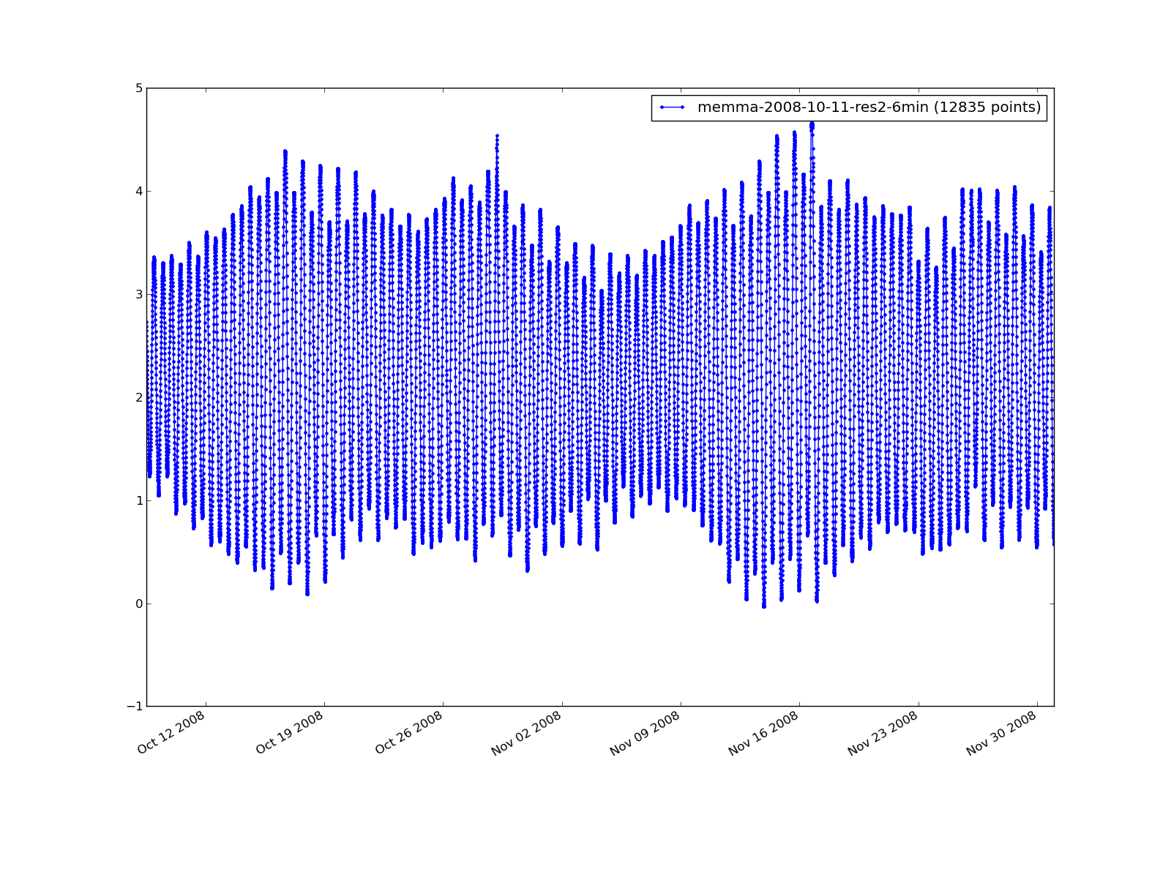
Outliers
From this
Gaps in data
Notes:
This data is from a tide station that CCOM students installed at pier of Maine Maritime Academy in Castine, Maine
Notice the random spikes and missing data.
The original data was collected at roughly 12 second intervals.
The processed tide data (on the right) needed to meet the NOAA specification for 6 minute intervals, starting on the top of each hour.

Slide 4
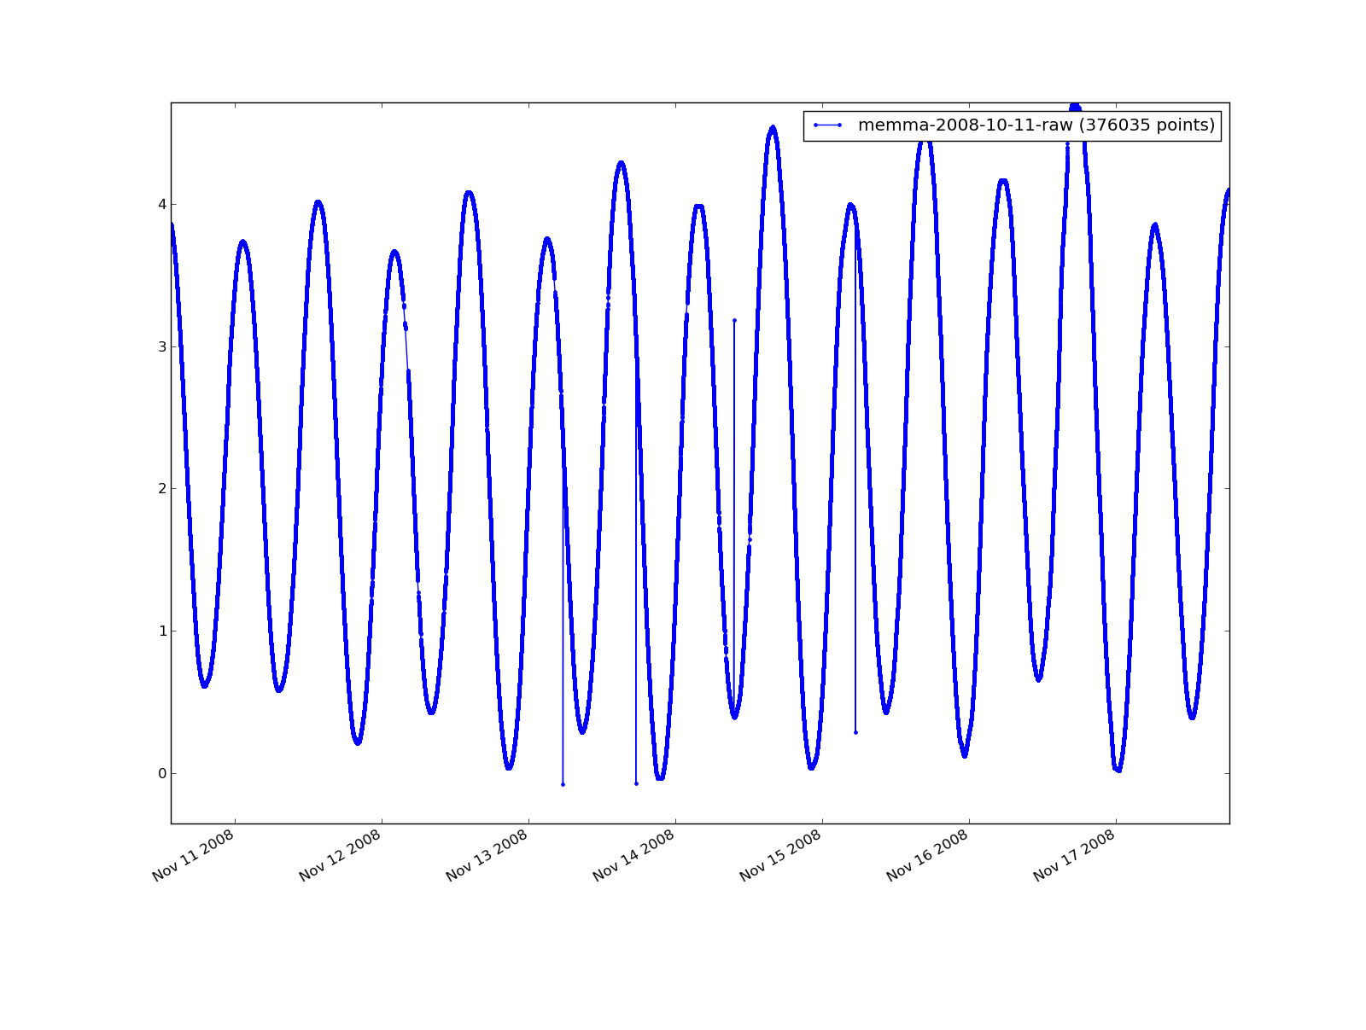
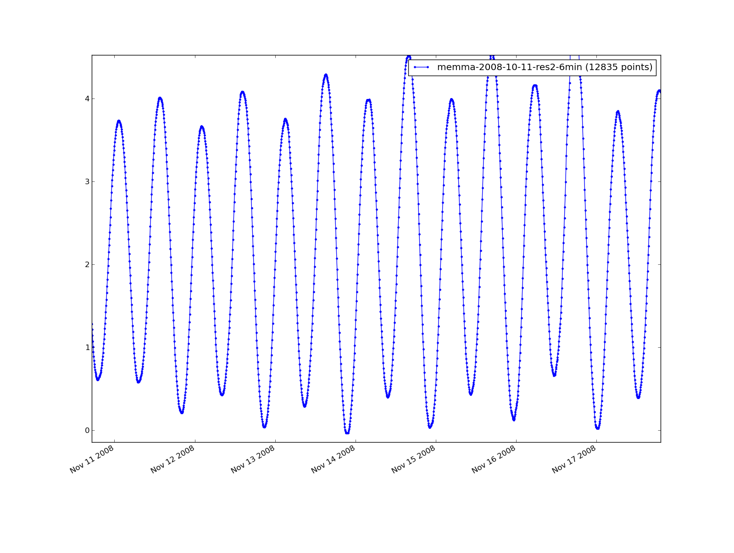
tideTools
Notes:
This is a detail of the previous data set.

Slide 5
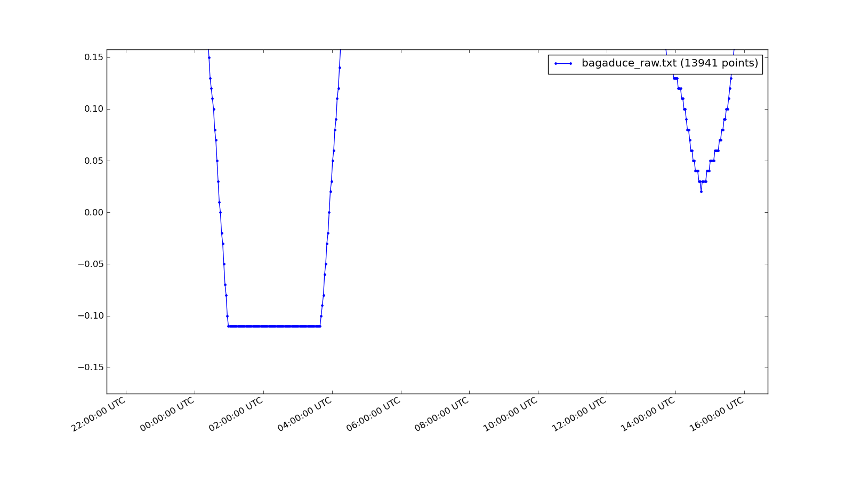
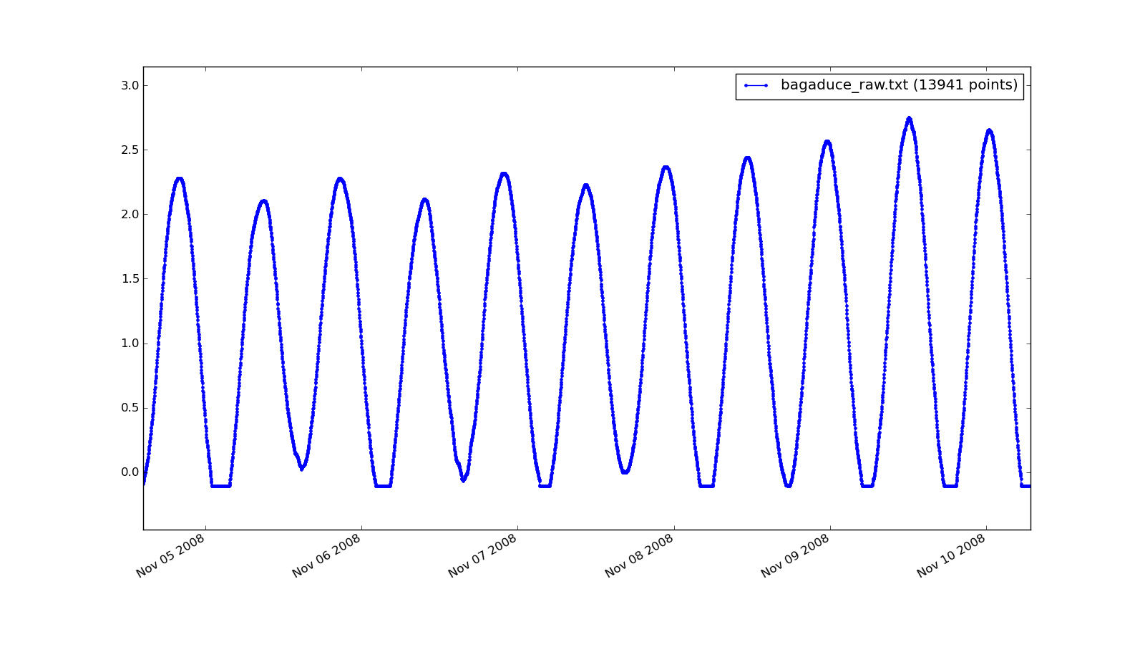
Clipped data resulting from poor tide station installation
tideTools
can NOT fix this problem
Notes:
This data was taken from a tide station where the sensor wasn’t set deep enough to record the lowest tides. These tools can not solve this kind of problem. Missing data at the high and low tides cannot be easily derived any method than copying it from the tide prediction. In some situations, that is acceptable, but we will never know what really happened.

Slide 6
Outline of this talk
Describe the suite of tools
Describe what each tool does
Explain how each tool performs its task
Notes:
The purpose of these tools is to process the raw data from tide recording stations and produce useful data for surveying or generating local tide predictors

Slide 7
tideTools
Written entirely in the portable and freely available programing language Python
Uses the Python libraries: scipy and matplotlib
Includes a data plotting tools “tidePlot” which performs similarly to MatLab’s plotting interface
The tools are run from the command line with command line arguments and options. The only graphical interface are in the tidePlot program.
Notes:
One of the purposes of this talk to demostrate a relatively simple use of the Python programming language, a freely available alternative to MATLAB.

Slide 8
from raw data log
to standard time & depth
Convert
limits sample
removes outliers
Trim
interpolates to fill blanks
use tideResample
Interpolate
smoothing
Filter
downsamples
aligns
use tideResample (again)
Downsample
finds peaks
Peaks
Notes:
Overview of process flow

Slide 9
tideConvert Input Formats
DATA LOGGER 3634
UNH-CCOM
Date: 31/10-2008
-------------------------------------------------------------------------------
Reading
Parameter Unit 5:21
-------------------------------------------------------------------------------
01 REFERENCE 839 840
02 Water level m 2.36
--------------------------------------- A system from Aanderaa Instruments ----
Time/Date : 31 October-2008 5:21:00
Time Ref. Ch002
5:21 840 2.36
5:23 840 2.36
5:25 840 2.35
5:27 840 2.35
5:29 840 2.35
5:31 840 2.35
5:33 840 2.35
5:35 840 2.35
5:37 840 2.35
Station Date Time Pred 6 Acoustc
DCP#: 1 1
Units: Feet Feet
Data%: NAVD GMT 100.00 100.00
Maximum: 6.13 6.19
Minimum: -6.57 -6.19
------- -------- ----- ------- -------
8423898 20100801 00:00 -2.80 -2.67
8423898 20100801 00:06 -2.93 -2.83
8423898 20100801 00:12 -3.06 -2.94
8423898 20100801 00:18 -3.18 -3.10
8423898 20100801 00:24 -3.28 -3.20
8423898 20100801 00:30 -3.38 -3.28
Aquatrac
Aanderaa – 2 minute avg
# START LOGGING UTC seconds since the epoch: 1223468878.55
# SPEED: 9600
# PORT: /dev/ttyS0
# TIMEOUT: 300.0
# STATIONID: memma
# DAEMON MODE: True
440,rmemma,1223468881.96
636 551 440,rmemma,1223468883.52
636 440,rmemma,1223468897.25
550 440,rmemma,1223468907.77
636 550 440,rmemma,1223468921.06
636 549 440,rmemma,1223468932.06
636 549 440,rmemma,1223468944.17
636 549 440,rmemma,1223468956.34
636 549 440,rmemma,1223468968.81
Aanderaa
raw pressure
06/30/2010,15:39:20,h-3611,2.452,m,G
06/30/2010,15:39:21,h-3611,2.455,m,G
06/30/2010,15:39:22,h-3611,2.457,m,G
06/30/2010,15:39:23,h-3611,2.457,m,G
06/30/2010,15:39:24,h-3611,2.457,m,G
06/30/2010,15:39:25,h-3611,2.460,m,G
06/30/2010,15:39:26,h-3611,2.459,m,G
06/30/2010,15:39:27,h-3611,2.458,m,G
06/30/2010,15:39:28,h-3611,2.458,m,G
Microwave
tide gauge
08/03/2010,14:24:00,SNS,0.000,M,G
08/03/2010,14:24:00,DAT,10.000,M,G
08/03/2010,14:24:00,BAT,12.8,V,G
08/03/2010,14:25:30,PAROS1,1.667, Avg,G
08/03/2010,14:25:30,P1STD,0.006, Std,G
08/03/2010,14:25:30,P1OUT,0,Samples,G
08/03/2010,14:30:00,SNS,0.000,M,G
08/03/2010,14:30:00,DAT,10.000,M,G
Numerous data formats from different tide recorders and settings
Bubbler
Notes:
Starting with tideConvert
When you use tideConvert and what it does.
The tide data can from collected from many different formats.
This one tool uses a pattern recognition method called “regular expressions.”

Slide 10
tideConvert Output format
2008/10/31 05:43:00 2.330000
2008/10/31 05:45:00 2.320000
2008/10/31 05:47:00 2.310000
2008/10/31 05:49:00 2.310000
2008/10/31 05:51:00 2.300000
2008/10/31 05:53:00 2.290000
2008/10/31 05:55:00 2.290000
2008/10/31 05:57:00 2.280000
2008/10/31 05:59:00 2.270000
2008/10/31 06:01:00 2.250000
2008/10/31 06:03:00 2.240000
2008/10/31 06:05:00 2.230000
2008/10/31 06:07:00 2.220000
2008/10/31 06:09:00 2.210000
Caris HIPS/SIPS
format
tideTools
format
Date
Time
(GMT)
Height
(m)
Notes:
tideConvert parses the tide station data file and produces a standard format.
Caris is Hydrographic and Sonar Data Processing System
The rest of the tideTools assume the data is in this standard format.

Slide 11
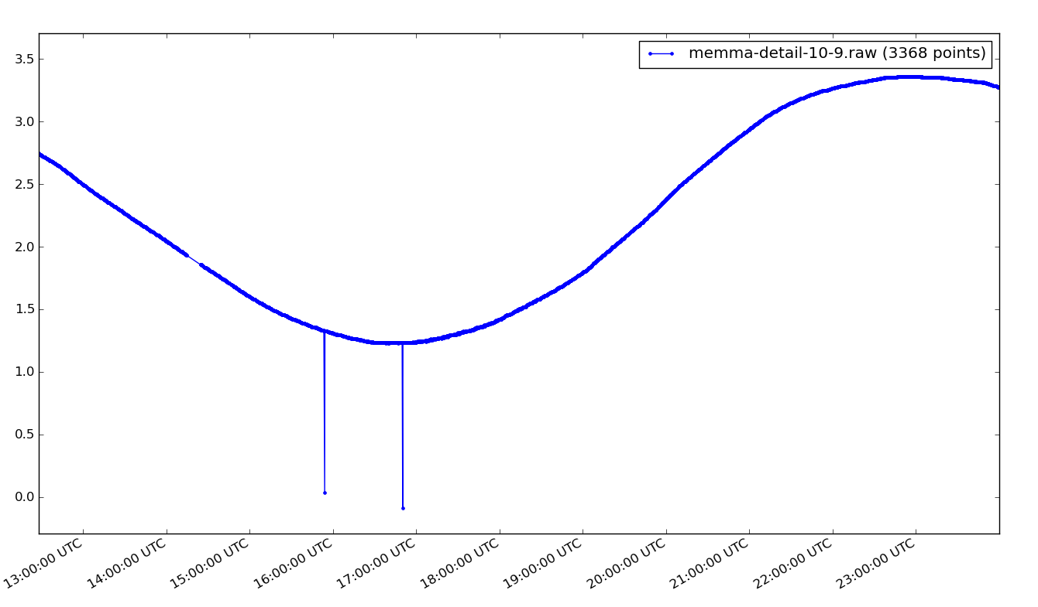
tideTrim Removes Outliers
Notes:
The first step is to eliminate unwanted data points. tideTrim not only can be used to selected a subset based on time of the original data, but also can remove outliers. By default, the filter uses 1.5 standard deviations from within a moving window of the data. You can specify any window dimensions you wish.
How the tideTools work will be explained shortly.
Let’s look at this spike in detail

Slide 12
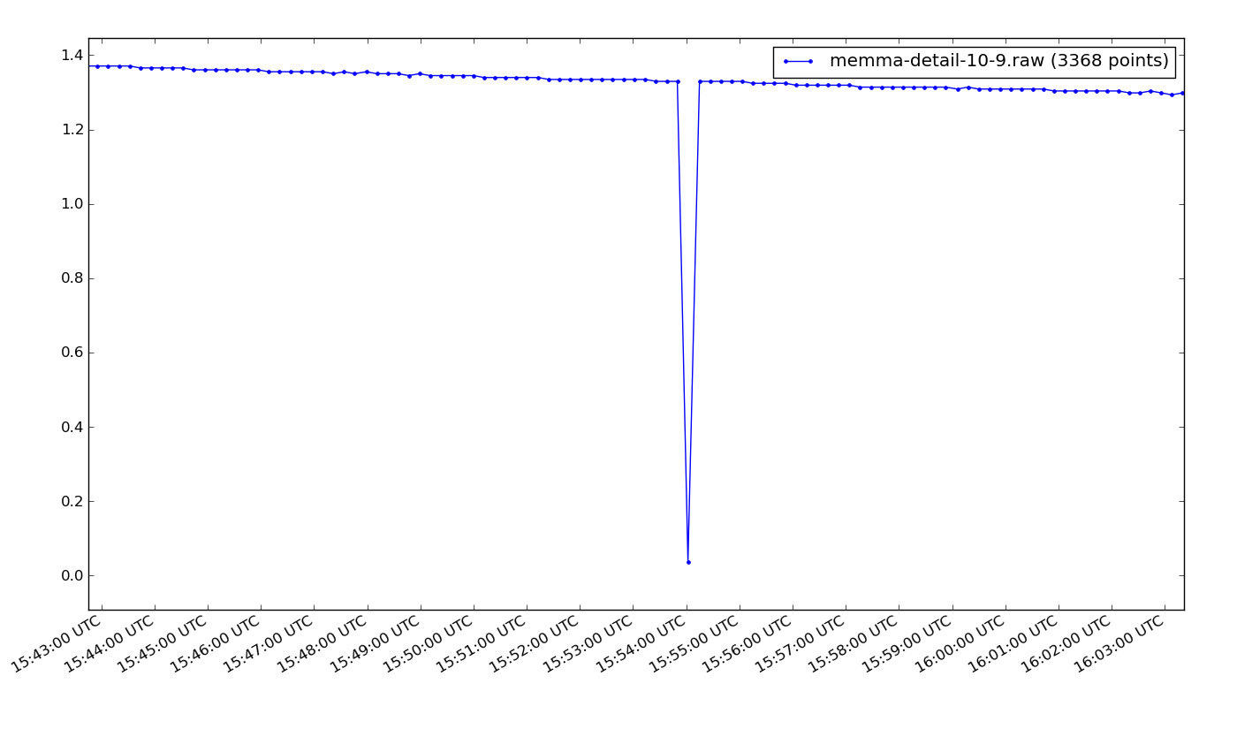
tideTrim
Notes:
Looks like one errant data point, zinging to zero depth

Slide 13
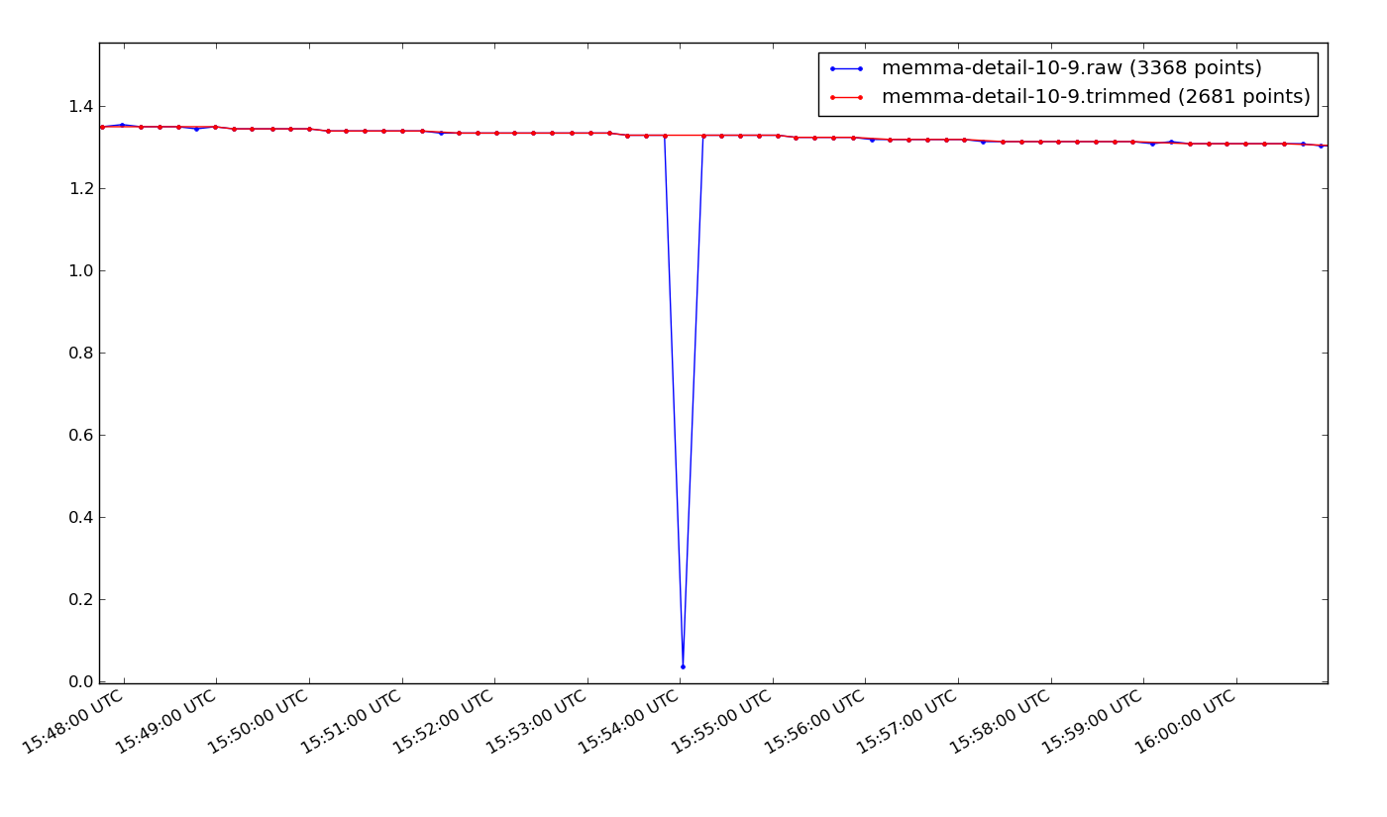
tideTrim
Notes:
The red points are the result of applying tideTrim. The blue point with a near zero value, has been eliminated.
Look more closely at the result

Slide 14
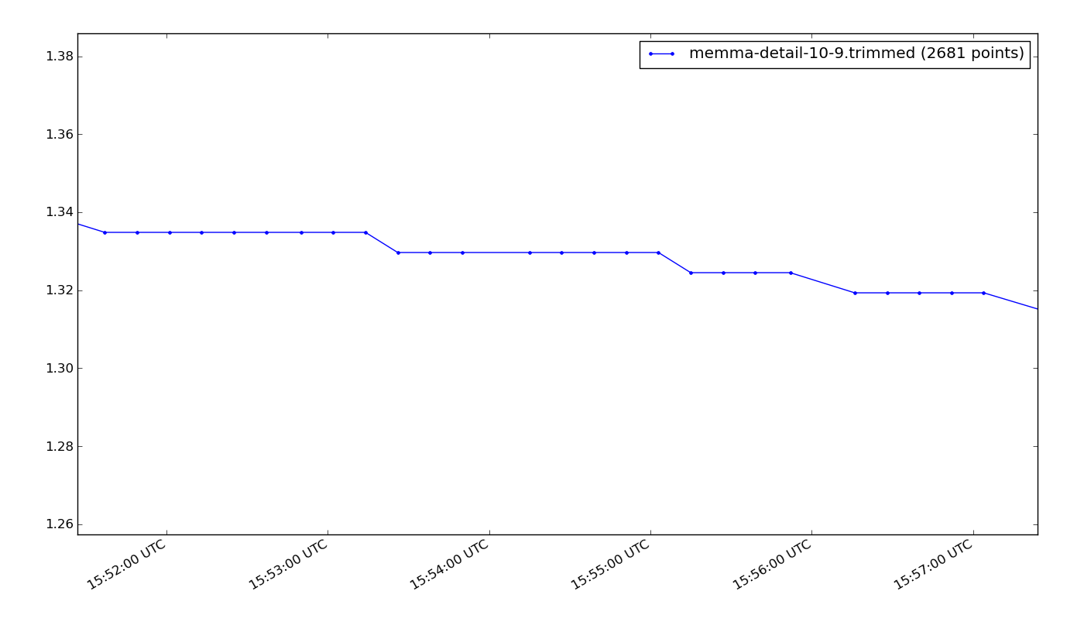
tideTrim leaves gaps where there were outliers
Was outlier
Now is gap in data
Notes:
tideTrim removes data points

Slide 15
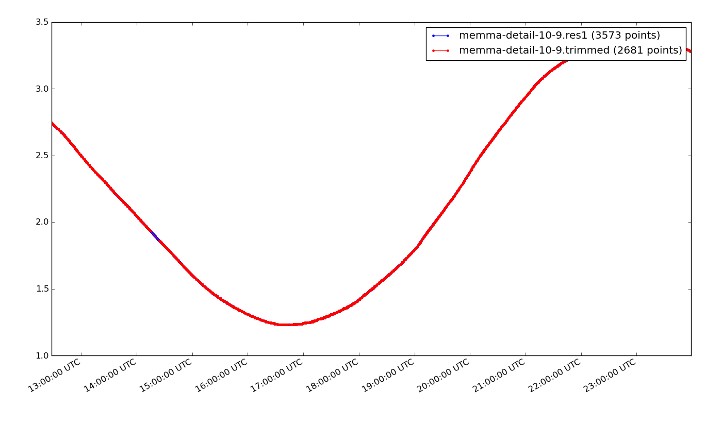
tideResample (interpolation)
Fills in gaps by using straight line interpolation
Notes:
The red points are from a data set with gaps. The blue points are the interpolated points.
Now we need to fill the gaps in the data.
This is, of course, a process that must be limited to small gaps.
It requires a some judgement. Large gaps should be become
break points in the data.
In other words, Each of the continuous blocks should be treated as a separate data set.
For the smaller gaps, such as those created by tideTrim, tideResample can be used to interpolate.
It will be important to have continuous data for the following steps of smoothing, downsampling, and peak location.
That is why we interpolate at this point.

Slide 16
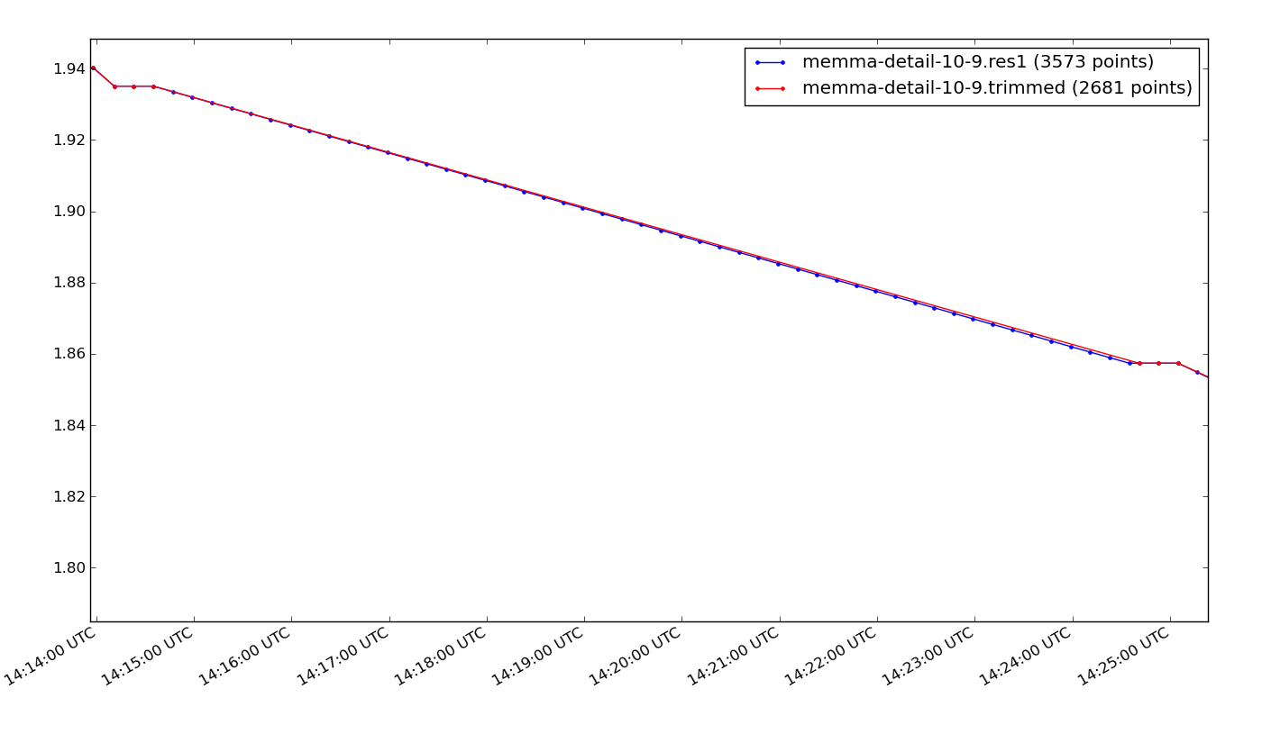
tideResample (interpolation)
blue points have been added by interpolation
Notes:
The first pass with tideResample and why you need to use it

Slide 17
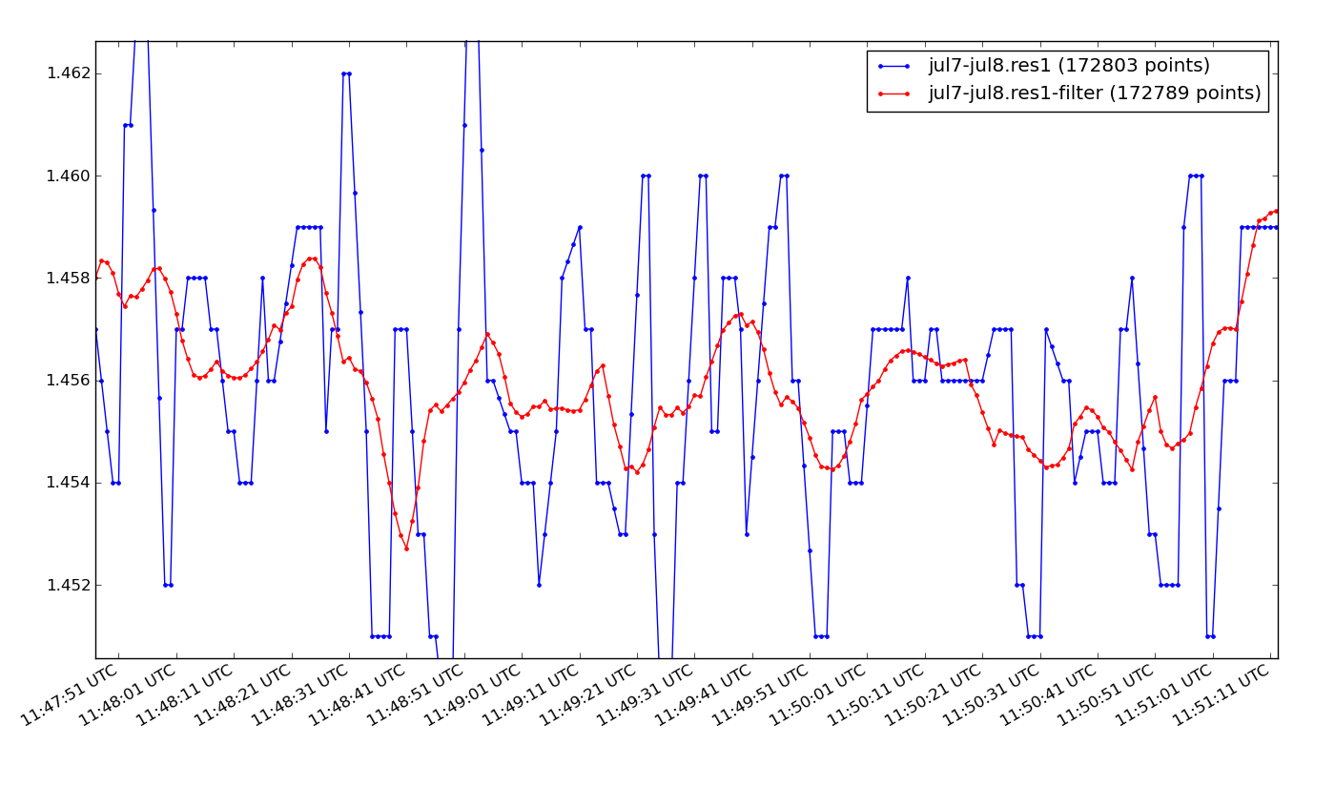
tideFilter
Smoothing using either a boxcar or weighted moving average
Notes:
This data is from a tide sensor that uses microwaves to measure distance between the transiever and the surface of the water. It was sampling at once a second. It has millimeter precision. (The data was provided by Andy McLeod of CCOM.)
We will eventually downsample this data, but we might want to use the clean and slightly smoothed data to do a spectral analysis, looking for ripples, waves, and swells.

Slide 18
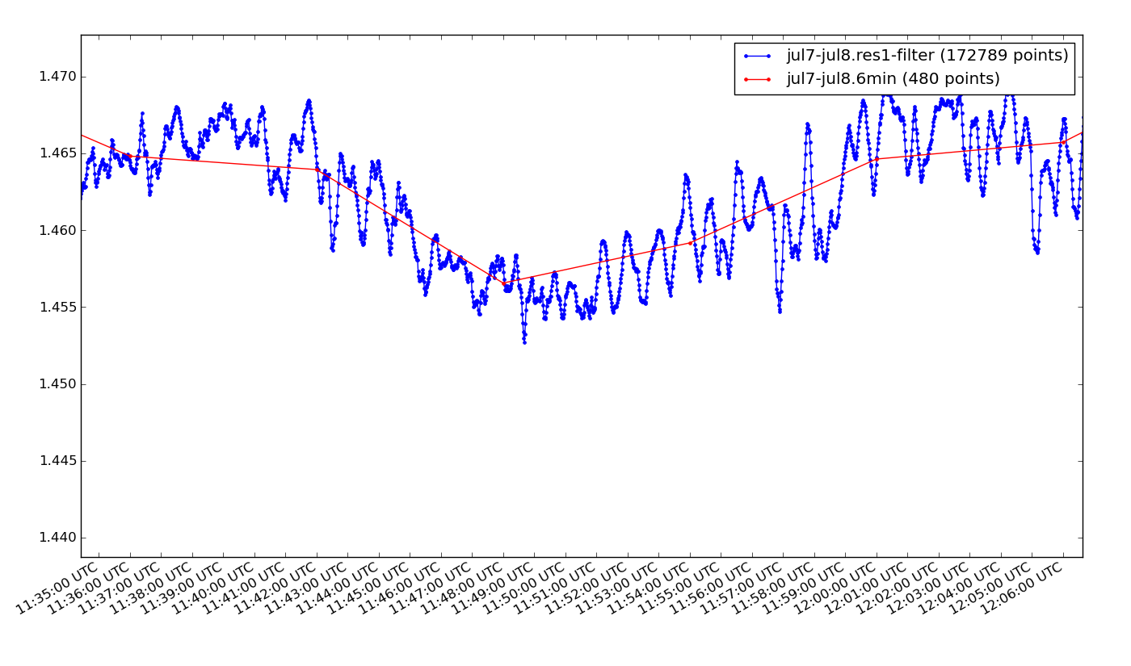
tideResample (downsample)
Side effect of downsampling is smoothing
Notes:
Blue is the smoothed data with 1 second samples.
Red is the downsampled to the NOAA standard of 6 minute averages.
We will look at how this average is achieved shortly, when we discuss how the tools work.
The original data is from the microwave tide station. The sample rate is one second. The blue line represents the data after it has been trimmed, interpolate to fill in the missing 1-second data, and then filtered to remove the “jagginess.” The red line is the result of resampling the blue line to a sample rate of once every 6-minutes.

Slide 19
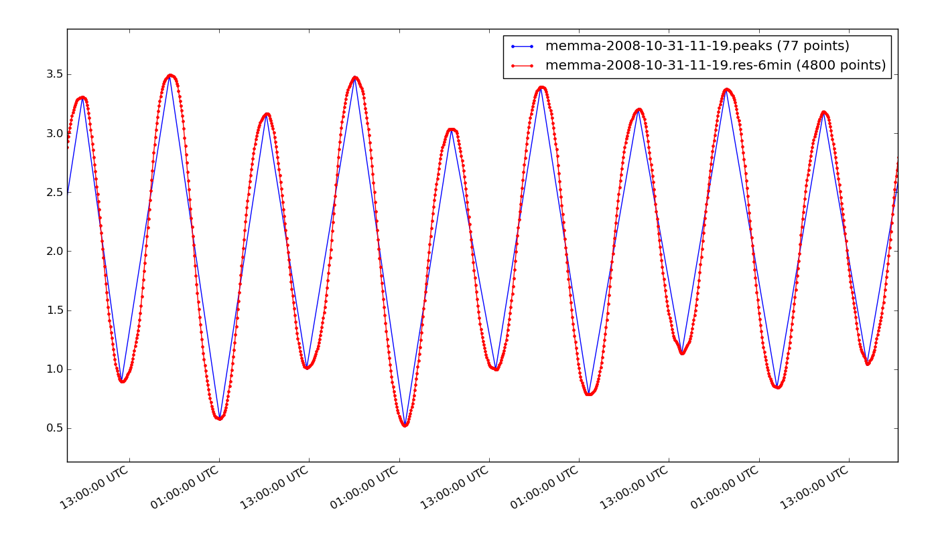
tidePeaks
2008/11/01 06:00:00 3.319166 H None
2008/11/01 11:48:00 0.781561 L None
2008/11/01 18:00:00 3.653732 H None
2008/11/02 00:06:00 0.556413 L None
2008/11/02 06:48:00 3.308720 H None
2008/11/02 12:00:00 0.896236 L None
2008/11/02 18:24:00 3.491601 H None
2008/11/03 01:06:00 0.578490 L None
2008/11/03 07:18:00 3.162547 H None
2008/11/03 12:42:00 1.009653 L None
2008/11/03 19:06:00 3.475038 H None
2008/11/04 01:48:00 0.521269 L None
2008/11/04 08:00:00 3.032133 H None
2008/11/04 13:54:00 0.999340 L None
2008/11/04 19:54:00 3.392300 H None
2008/11/05 02:18:00 0.788040 L None
2008/11/05 08:54:00 3.204299 H None
2008/11/05 14:42:00 1.133464 L None
2008/11/05 20:36:00 3.376477 H None
2008/11/06 03:24:00 0.844706 L None
2008/11/06 09:36:00 3.183422 H None
2008/11/06 15:24:00 1.044095 L None
Finds peaks in time series
Notes:
With the clean and smooth data, it is fairly easy to find the peaks.
The blue line connects the points that tidePeaks has found. The output of
peaks file contains not only the time and height of the peak, but also whether it is a high (H) or low (L), and optionally the name of station which is valuable
if you merge the data with predictions or with date from other stations for the sake of comparison.

Slide 20
How each tool works
Notes:
Now we will look at how the most important tools work.

Slide 21
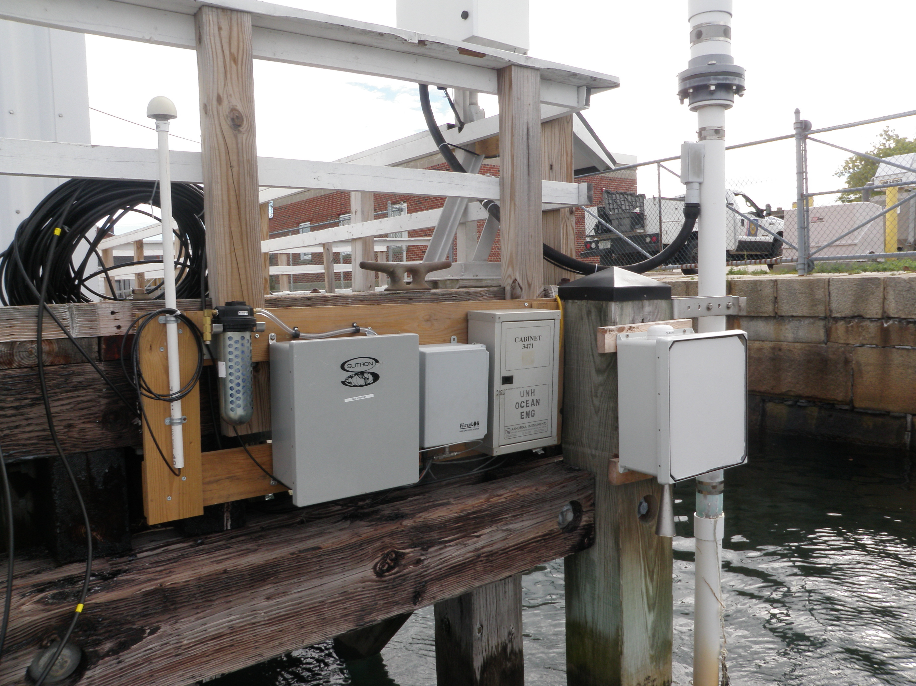
Several different types of tide recorders at a shared location

Slide 22
tideConvert
DATA LOGGER 3634
UNH-CCOM
Date: 31/10-2008
-------------------------------------------------------------------------------
Reading
Parameter Unit 5:21
-------------------------------------------------------------------------------
01 REFERENCE 839 840
02 Water level m 2.36
--------------------------------------- A system from Aanderaa Instruments ----
Time/Date : 31 October-2008 5:21:00
Time Ref. Ch002
5:21 840 2.36
5:23 840 2.36
5:25 840 2.35
5:27 840 2.35
5:29 840 2.35
5:31 840 2.35
5:33 840 2.35
5:35 840 2.35
5:37 840 2.35
Station Date Time Pred 6 Acoustc
DCP#: 1 1
Units: Feet Feet
Data%: NAVD GMT 100.00 100.00
Maximum: 6.13 6.19
Minimum: -6.57 -6.19
------- -------- ----- ------- -------
8423898 20100801 00:00 -2.80 -2.67
8423898 20100801 00:06 -2.93 -2.83
8423898 20100801 00:12 -3.06 -2.94
8423898 20100801 00:18 -3.18 -3.10
8423898 20100801 00:24 -3.28 -3.20
8423898 20100801 00:30 -3.38 -3.28
06/30/2010,15:39:20,h-3611,2.452,m,G
06/30/2010,15:39:21,h-3611,2.455,m,G
06/30/2010,15:39:22,h-3611,2.457,m,G
06/30/2010,15:39:23,h-3611,2.457,m,G
06/30/2010,15:39:24,h-3611,2.457,m,G
06/30/2010,15:39:25,h-3611,2.460,m,G
06/30/2010,15:39:26,h-3611,2.459,m,G
06/30/2010,15:39:27,h-3611,2.458,m,G
06/30/2010,15:39:28,h-3611,2.458,m,G
# START LOGGING UTC seconds since the epoch: 1223468878.55
# SPEED: 9600
# PORT: /dev/ttyS0
# TIMEOUT: 300.0
# STATIONID: memma
# DAEMON MODE: True
440,rmemma,1223468881.96
636 551 440,rmemma,1223468883.52
636 440,rmemma,1223468897.25
550 440,rmemma,1223468907.77
636 550 440,rmemma,1223468921.06
636 549 440,rmemma,1223468932.06
549 440,rmemma,1223468944.17
08/03/2010,14:24:00,SNS,0.000,M,G
08/03/2010,14:24:00,DAT,10.000,M,G
08/03/2010,14:24:00,BAT,12.8,V,G
08/03/2010,14:25:30,PAROS1,1.667, Avg,G
08/03/2010,14:25:30,P1STD,0.006, Std,G
08/03/2010,14:25:30,P1OUT,0,Samples,G
08/03/2010,14:30:00,SNS,0.000,M,G
08/03/2010,14:30:00,DAT,10.000,M,G
snttRE = re.compile(r'^\s*(\d+)\s+(\d+)\s+(\d+),(\w+),(\d+\.\d+)')
dttnRE = re.compile(r'^\s*(\d+\/\d+\/\d+\s+\d+:\d+)\s+(\d+)\s+(-?\d+\.\d+)')
tvwlRE = re.compile(r'(\d+:\d+)\s+(-?\d+\.\d+)\s+(-?\d+\.\d+)\s+(-?\d+\.\d+)')
cdlRE = re.compile(r'^\s*(\d+\/\d+\/\d+),(\d+:\d+:\d+),\S*,(\d+\.\d+)')
Regular Expressions
Notes:
Each data source has a different format. The date and time are encoded differently.
The raw data (memma) time stamps using seconds from an epoch.
The data may be different units, or even raw data that needs to be interpreted.
The basic tool for parsing the data is the “regular expression”
“Regular Expressions” are concise rules for a parsing generator.
Parsing is the process of syntactic analysis, the study of the “grammar” or
how the characters, words, and blocks of text are differentiated and related.
It is a core part of computer programming languages and information processing.
Because of the esoteric nature of parsing generators to the non-programmer, it is the only technology that is beyond the novice programmer.
This winter, Steve and I plan on extending tideConvert to use a simpler method for describing raw tide formats. It will probably use XML, which is structurally similar to the Web description language HTML.

Slide 23
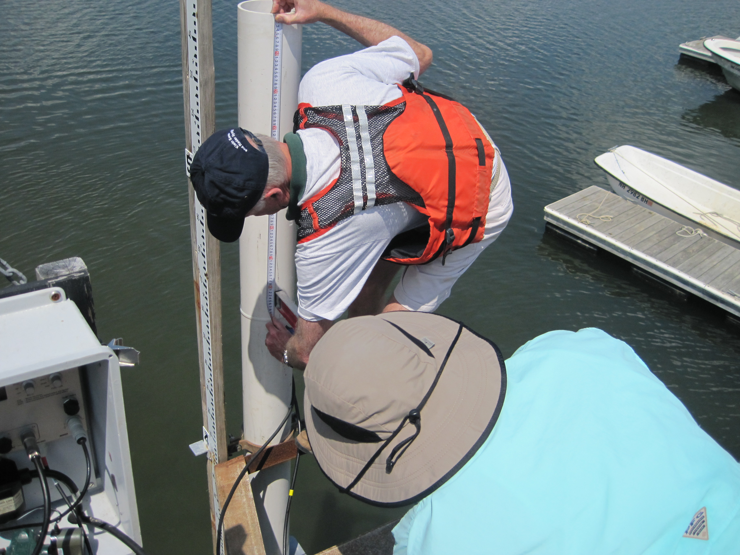
Installing a tide station

Slide 24
tideTrim
Is this point an outlier?
Time
Notes:
tideTrim can produce a time segment of the original data. That is a trivial problem.
But tideTrim, by default, also does statistical filtering. This is a more interesting programming problem.
The goal is to eliminate points that lie outside of some probabilistic limit of the set of nearby points.
For example, lets analyze the highlighted point.

Slide 25
tideTrim
Time
Notes:
We define a window of analysis. tideTrim, by default, uses a window width of 13

Slide 26
tideTrim
Time
Notes:
. That means, there are six points on either side of the point under analysis.
You can specify any width you wish.

Slide 27
tideTrim
Time
Notes:
Next we define the line derived from a least squares linear regression of the points in the window.

Slide 28
tideTrim
Time
Notes:
Then we establish the “okay” zone on either side of the line. By default, tideTrim uses 1.5 times the standard deviation of the points in the window.

Slide 29
tideTrim
Time
Notes:
Any points in the area outside the “okay” zone, are considered “bad” points.

Slide 30
tideTrim
Time
Notes:
And are eliminated

Slide 31
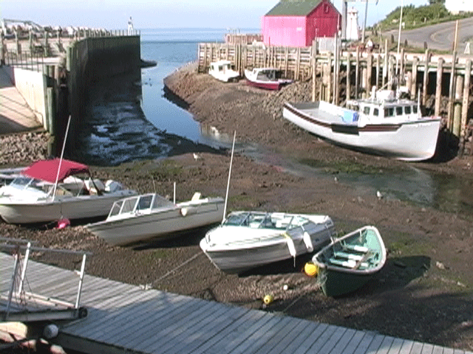

Slide 32
tideResample interpolation
Missing Data point..
What should their values be?
Time
Notes:
tideResample can be used to interpolate for missing points such as those that eliminated by the statistical trim program.

Slide 33
tideResample interpolation
First step, determine the intended data sample interval (rate)
finding the interval
Mode : most common value
Time
Notes:
We’ll see later that tideResample can be used for more than filling gaps, but for this stage in the data processing we don’t specify a new time interval.
tideResample will do a preliminary analysis of the data to determine the sample rate.
Then it will reanalyze the data looking for data missing from the times established by that interval.
When it finds a gap in the data..

Slide 34
tideResample interpolation
2nd step: straight line interpolation for the missing data points at the interval
Time
Notes:
We’ll see later that tideResample can be used for more than filling gaps, but for this stage in the data processing we don’t specify a new time interval.
tideResample will do a preliminary analysis of the data to determine the sample rate.
The it will reanalyze the data looking for data missing from the times established by that interval.
When it finds a gap in the data..

Slide 35
tideResample downsampling
The same program that is used for interpolation is
Also used to downsample, i.e. change the sample interval.
Time
Notes:
Now let’s see tideResample can be used to downsample a data set. (It is also possible to “upsample,” if you have a need to do so.)
If you specify an new interval, tideResample creates a list of new times. These times need not coincide with multiples of the existing data interval.

Slide 36
tideResample downsampling
Original sample intervals
Proposed sample intervals
Time
Notes:
Now let’s see tideResample can be used to downsample a data set. (It is also possible to “upsample,” if you have a need to do so.)
If you specify an new interval, tideResample creates a list of new times. These times need not coincide with multiples of the existing data interval.

Slide 37
tideResample downsampling
Binning existing data in bins centered on new sample intervals
Time
Notes:
Data windows are established the span the time from halfway between the new time and the previous time of the new interval set and to halfway to the
next new interval time.

Slide 38
tideResample downsampling
by Simple Averaging
Time
Notes:
The simple average of the points within each window gives us the value for the new interval.

Slide 39
tideResample downsampling
by Simple Averaging
Time
Notes:
The simple average of the points within each window gives us the value for the new interval.

Slide 40
tideResample downsampling
by Least Squares Averaging
Time

Slide 41
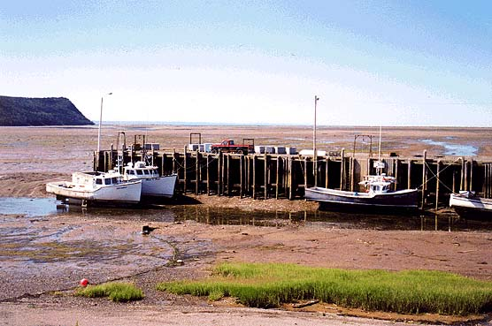

Slide 42
tideFilter
Before applying a boxcar or weighted average smoothing (low pass filter)…
All time slots must have data

Slide 43
tideFilter

Slide 44
tideFilter

Slide 45
tideFilter

Slide 46
tideFilter

Slide 47
tideFilter

Slide 48
tideFilter

Slide 49
tideFilter

Slide 50
tideFilter

Slide 51
tideFilter

Slide 52
tideFilter

Slide 53
tideFilter

Slide 54
tideFilter

Slide 55
tideFilter

Slide 56
tideFilter

Slide 57
tideFilter

Slide 58
tideFilter

Slide 59
tideFilter
default: Boxcar moving average

Slide 60
tideFilter
default: Boxcar moving average

Slide 61
tideFilter
Weighted moving average

Slide 62

Mont Saint-Michel

Slide 63
tidePeaks
To find peaks, we look for the change of sign of the slope within an moving sample window
for tides, window is 60 minutes
Notes:
Similar in concept to finding the inflection points in an equation, we move through the data looking to see if the slope changes direction.
But we also need to eliminate jitter inflection points, so we evaluate a moving window for the maximum and minimum.
The red right bracket represents the leading limit of the window.
The window is centered on the point in question.
For tide data, we use a window that is one hour wide.
The orange dashed line is the maximum within the window.
The purple dashed line is the minimum.
The arrows represent the slope to and from the point being analyzed.

Slide 64
tidePeaks
Notes:
The slope changes on the next point. But the inflection is between the maximum and minimum.

Slide 65
tidePeaks

Slide 66
tidePeaks
Notes:
Again the slope has change, but not at the maximum nor minimum.

Slide 67
tidePeaks

Slide 68
tidePeaks

Slide 69
tidePeaks
Notes:
The has changed, but this time it is at the maximum. This is a high tide.

Slide 70

Discussion
Command Line
Filters
Downsampling techniques
Interpolation methods

Slide 71
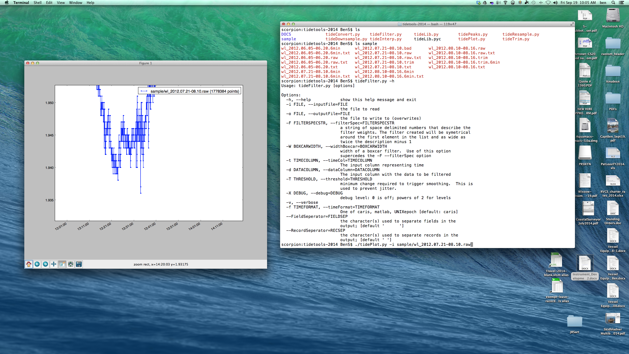
Discussion command line

Slide 72
Discussion filters
boxcar moving average

Slide 73
Discussion filters
Weighted moving average

Slide 74
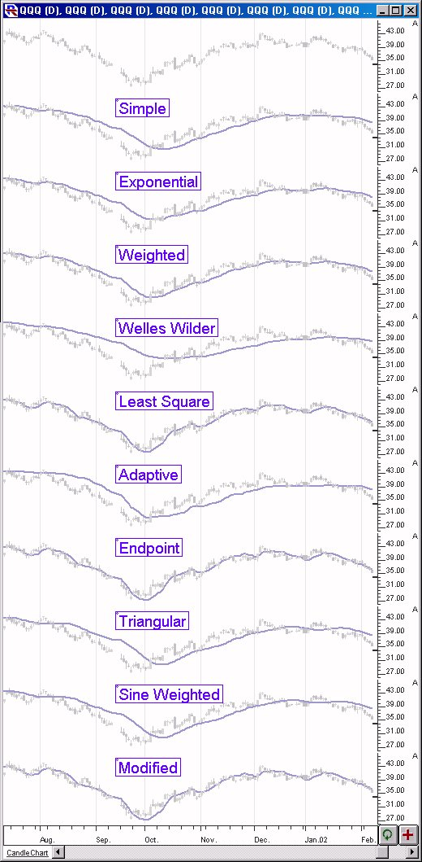
Discussion filters

Slide 75
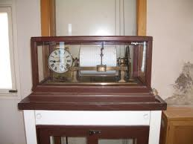
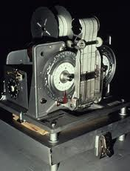
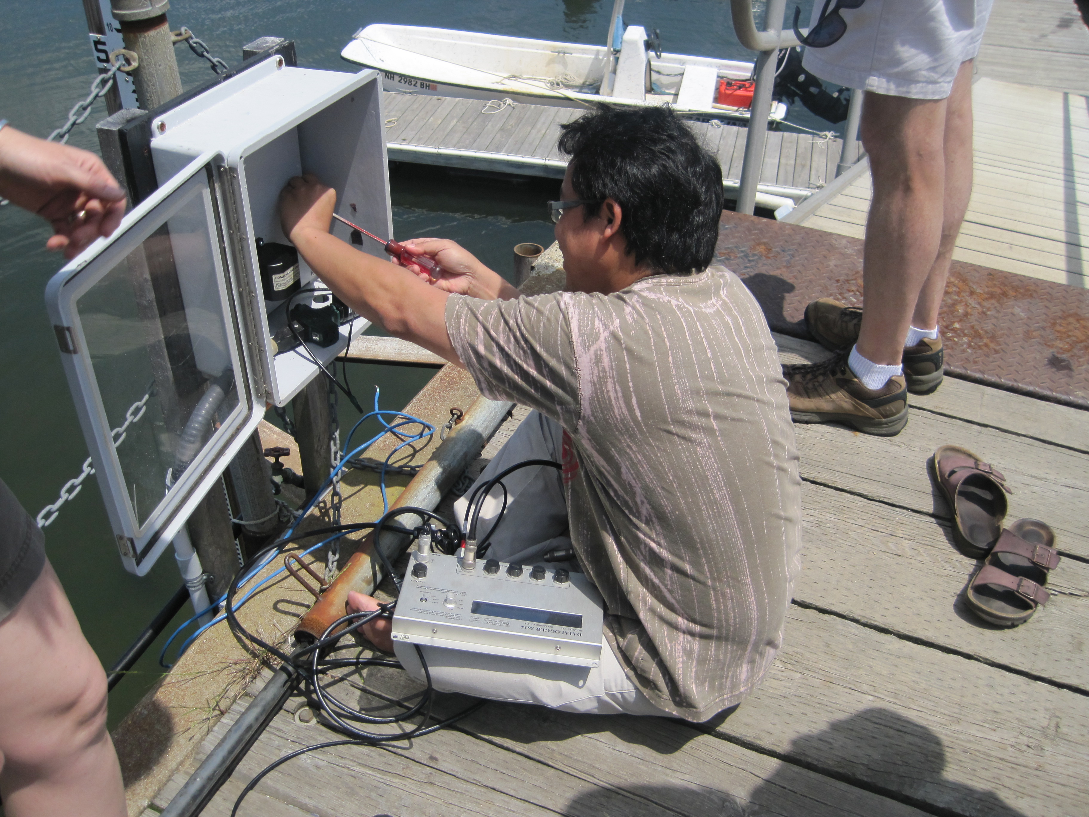
Discussion downsampling

Slide 76
Discussion downsampling
by Simple Averaging
Notes:
The simple average of the points within each window gives us the value for the new interval.

Slide 77
Discussion downsampling
by Least Squares Averaging

Slide 78
Discussion downsampling
with decimation
Notes:
The simple average of the points within each window gives us the value for the new interval.

Slide 79
Discussion downsampling
with spot sampling
value of nearest
Notes:
The simple average of the points within each window gives us the value for the new interval.

Slide 80
Discussion Interpolation
default: straight line

Slide 81
Discussion Interpolation
spline

Slide 82
Additions and Improvements in the Works
rewrite tideConvert so that it operates from XML input and output descriptions
add the ability to break a file into parts if time gaps are greater than some configuration value (tideTrim)
write tideAdjust to make phase and amplitude adjustments as well as clock drift adjustments
interface to tappy and ttide (programs for tidal analysis)

Slide 83
Thanks
to everyone at CCOM, and especially:
Brian Calder
Kurt Schwehr
Andy McLeod
Jim Irish
Tom Lippmann
Monica Wolfson
Sean Denny

Slide 84
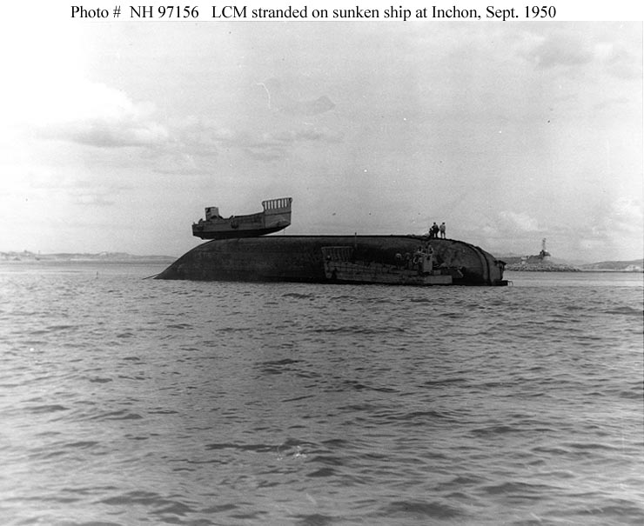
The tide did it!
Notes:
This is a low tide.

